Slide 1
Art Exhibition
Theme: Experience
By Rudolf Bauer

Slide 2
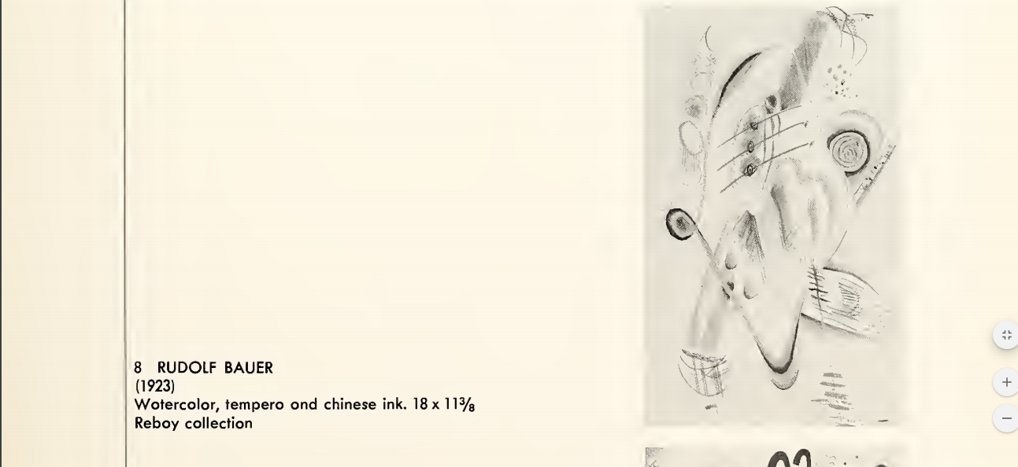

Slide 3
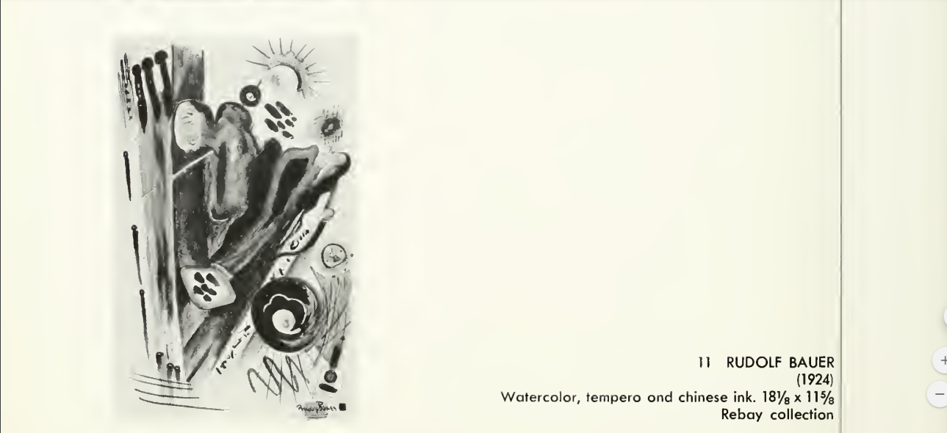

Slide 4
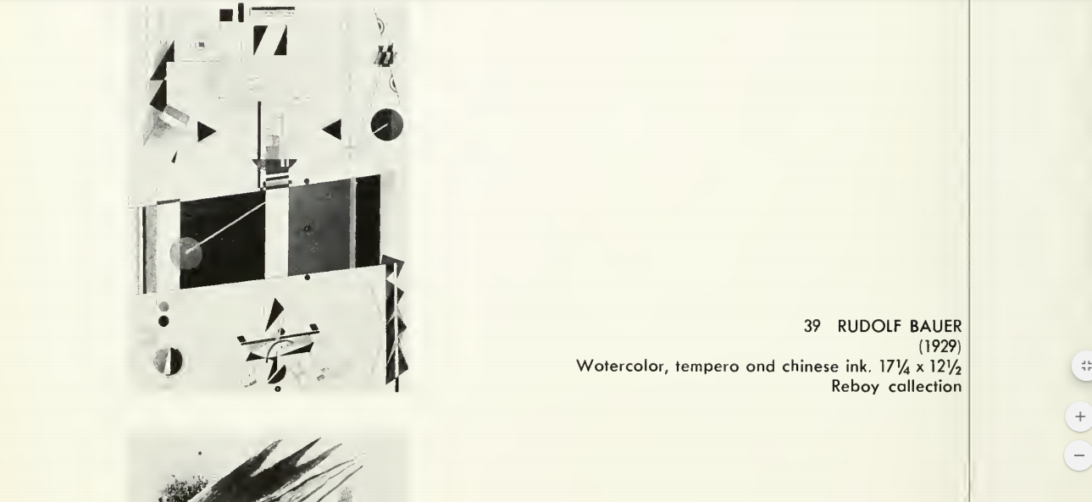

Slide 5
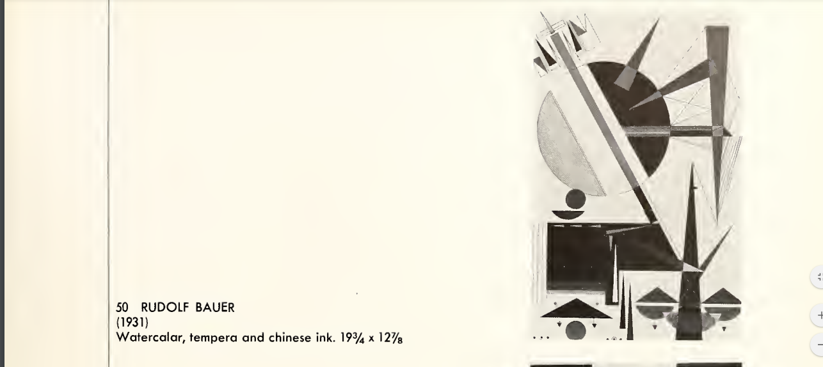

Slide 6
